Slide 1

Trusting and Following
Everyday Spirituality

Slide 2
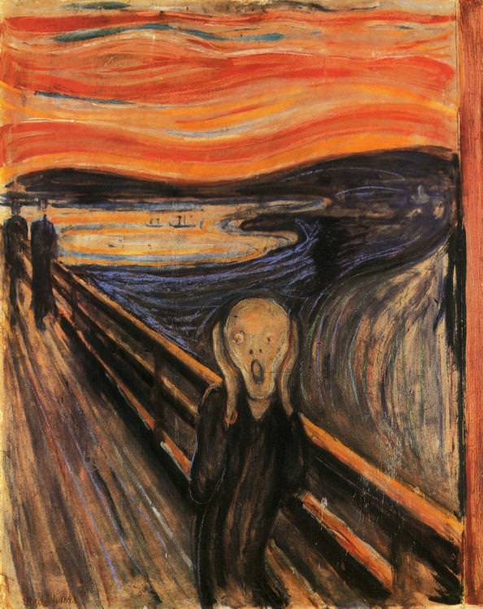
Notes:
a feeling of deep anxiety or dread, typically an unfocused one about the human condition or the state of the world in general.

Slide 3
Everyday Spirituality

Slide 4
Resilient Sacramental Everyday Spirituality

Slide 5
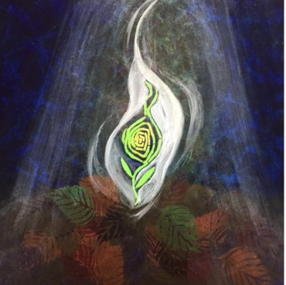

Slide 6
Betting the farm…
What strikes you as most important part of our vision statement?
  Embrace God’s Mission
  Equip God’s People
  Deepen Cong. Vitality
  Enhance Local and Global Mission
  Develop Servant Leaders

Slide 7
What is not part of our mission statement….
we cultivate life-giving congregations,
We compete as ruthless independent congregations
cooperate in the life of the ELCA.
By God's grace, together we have what we need.

Slide 8
What is not part of our mission statement?
God places us in cities, farms and towns together
To plant God's Word in the world.
Walking together in anxiety and fear
We cultivate life-giving congregations,

Slide 9
Our mission statement
God places us in cities, farms and towns together To plant God's Word in the world. Walking together in confidence…

Slide 10
Our mission statement
….we cultivate life-giving congregations, nurture partner ministries, and cooperate in the life of the ELCA.
By God's grace, together we have what we need.

Slide 11
What is our Largest Challenge?
Congregational Vitality
Deepen our local and global mission
Develop servant leaders

Slide 12
Largest Opportunity
Congregational Vitality
Deepen our local and global mission
Develop servant leaders
Notes:
Conversation?

Slide 13
Resilient Everyday Sacramental Spirituality

Slide 14
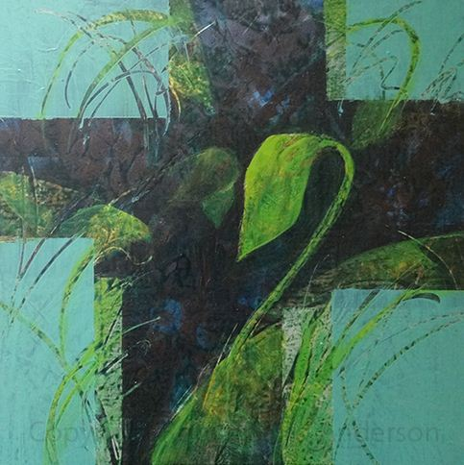

Slide 15
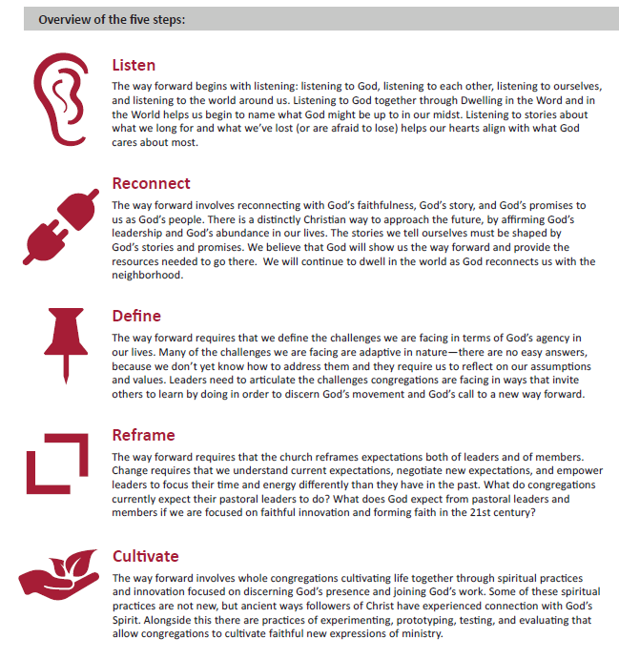
Faithful Innovation

Slide 16
Possible programs sponsored by your synod….which do you think would have the greatest impact?
Faith Formation Strategies
Older Adult Ministry
Preaching Emphasis -
Evangelizing 101

Slide 17
Of these possible programs sponsored by your synod….which do you think would have the greatest impact
Worship Assistant Training
Training Key Council Leaders
Path to a Bible Study Certificate

Slide 18
Healthy Everyday Spirituality Sees the Intersections

Slide 19
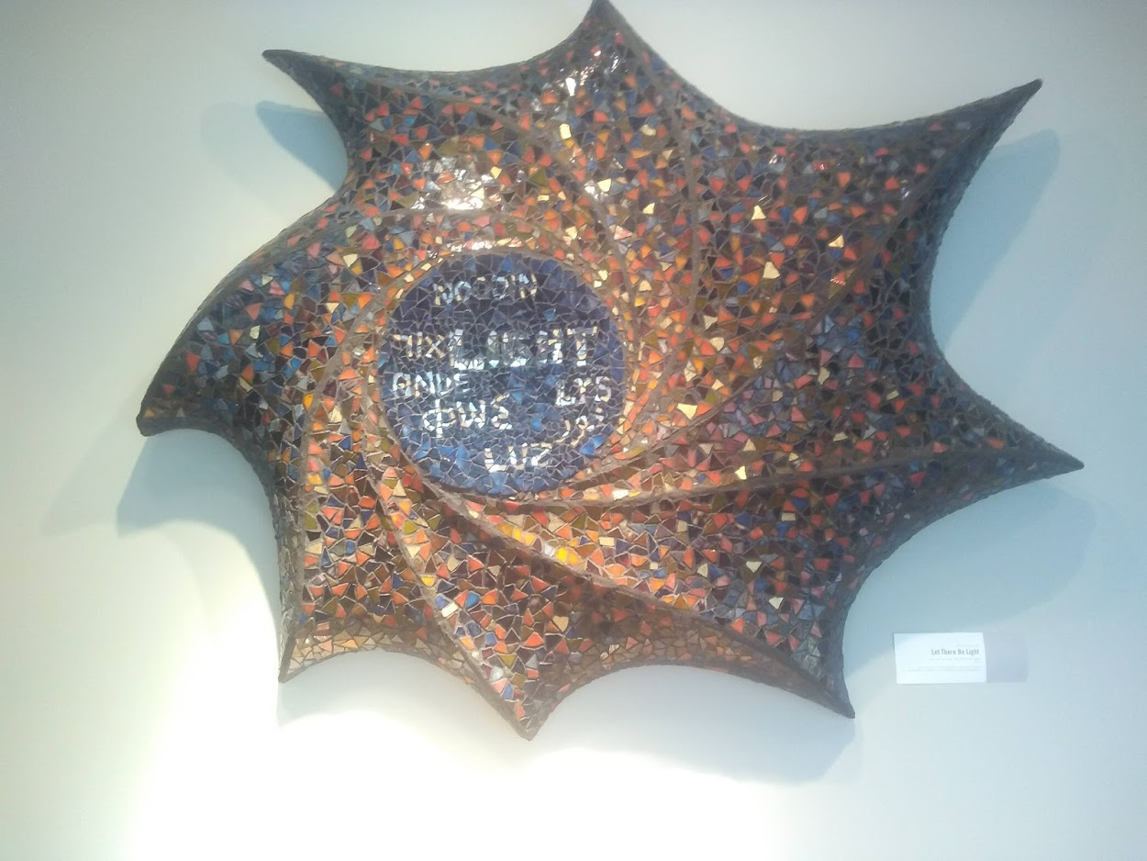
Intersections of Faith, Science and Business

Slide 20
Stewardship of the Land: Faith and Technology
Association of Teaching Theologians - 2018
“Trust in the Lord, and do good; dwell in the land
and befriend faithfulness.”
PSALM 37

Slide 21

Weeds…..
As a faithful steward of the land, how are you going to grow your crops while fighting/managing weeds of all kinds?

Slide 22
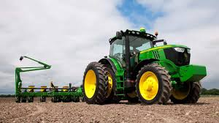
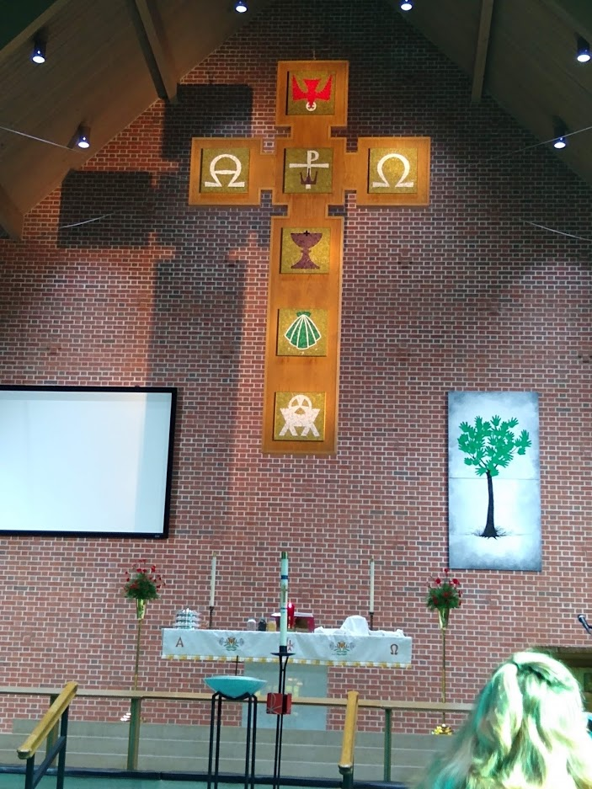
Altar in Church and Altar in God’s World

Slide 23
  Deepen Congregation Vitality

Slide 24
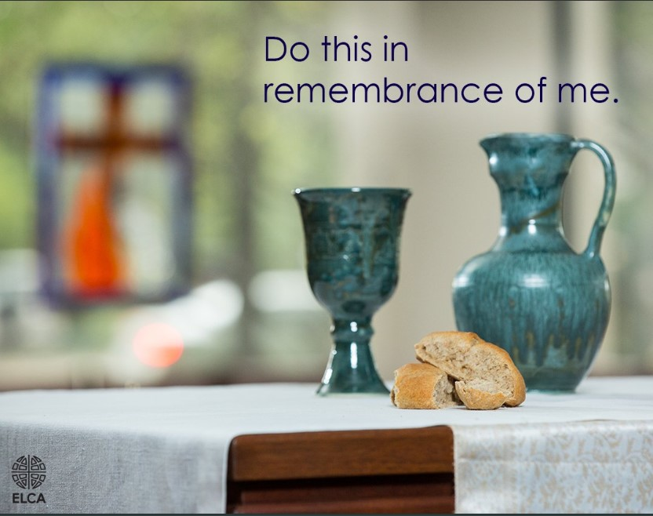
Sacramental Everyday Spirituality

Slide 25

Baptismal Discipleship
Prayer
Invite
Give/ Generosity
Study
Serve
Encourage
Worship
Love
Forgive

Slide 26
To get unstuck, congregations need to stop asking “church questions” (e.g. How do we fix the church?) and start asking “God questions” (e.g. “What is God doing and how do we join?”). .” Bobbit – Cong. Vitality Report
Notes:
“Church questions limit their imagined solutions to past versions of what it means to be “fixed”. God questions allow them to see opportunities and imagine new, more contextually relevant image of succs
es

Slide 27
Vital Congregations Have a Strong Relationship with
Holy Spirit works to create, sustain and send
Great Commandment – Love God heart, soul, strength and mind and love neighbor as self
Great Commission – Go. Make disciples of all nations/peoples
God
Each Other
God’s World

Slide 28
We equip leaders
to grow gracious disciples
in communities of Jesus
who care for God’s world.

Slide 29
Congregational Vitality: On participation are you?
Growing
Stable
Declining

Slide 30
Congregational Vitality: Momentum … are you?
Gaining
Stable
Losing

Slide 31
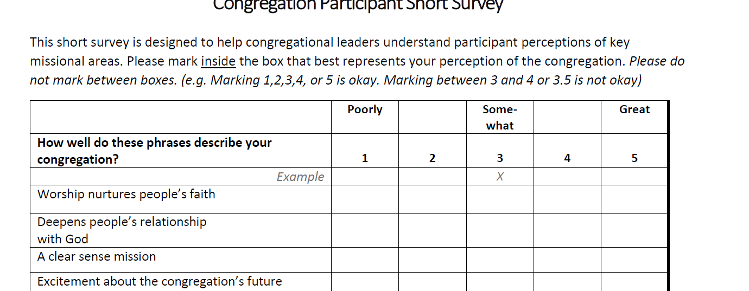
ELCA Congregational Vitality Survey
http://www.congregationalvitalitysurvey.com

Slide 32
We have to be willing to look beyond current models…
Box
Book
Preacher

Slide 33
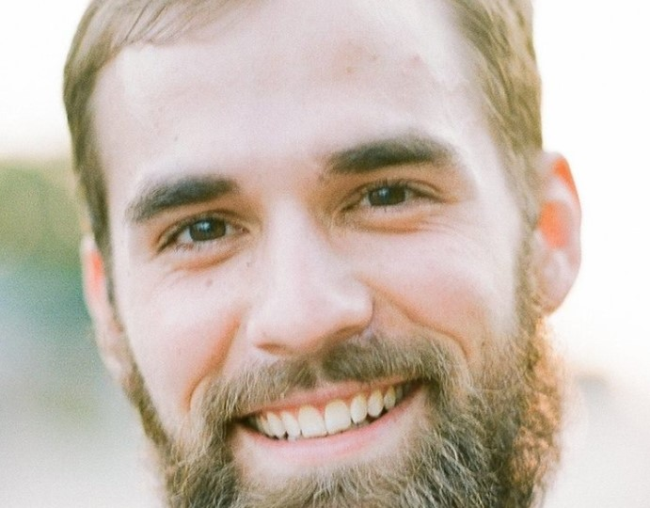
Renegotiating the Role of Pastors and People -

Slide 34
Blaming
Quick Fix
Lack of Leadership
Reactivity
Herding
The Systems Circle

Slide 35
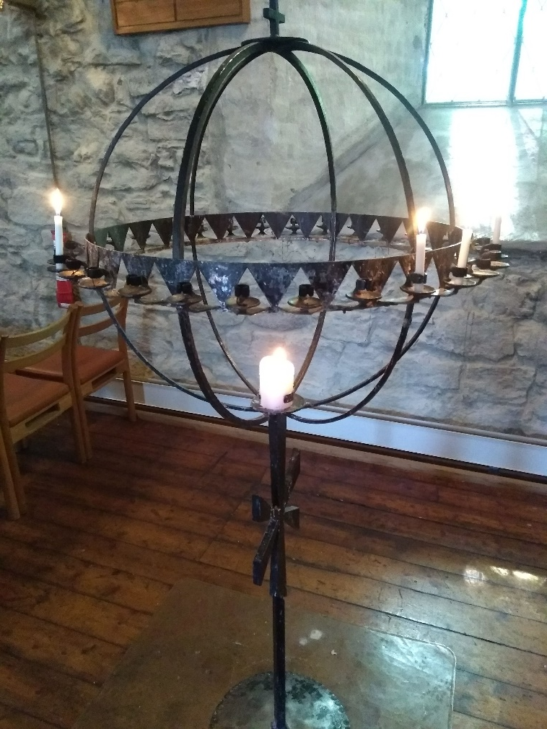
What do we need to let go of to strategically engage other work?

Slide 36
Evaluation
Question
Investigate
Reflect
Improve
Share
Sustain
Creating a Culture of Inquiry

Slide 37
What is your best hunch about how to reach sustainability for mission?
Anchor Church Model
Multipoint Parish – 2/3/4
Merge churches – instead of closing
Large area parishes 5-7 congregations

Slide 38
  Enhance Local and Global Mission

Slide 39
Where is God sending you…and your congregation these days?
To Share the Promises

Slide 40
Identity and Vocations
Identity
and
Vocation(s)

Slide 41

Core Callings… https://www.day8strategies.com/blog/knowing-your-core---essential

Slide 42
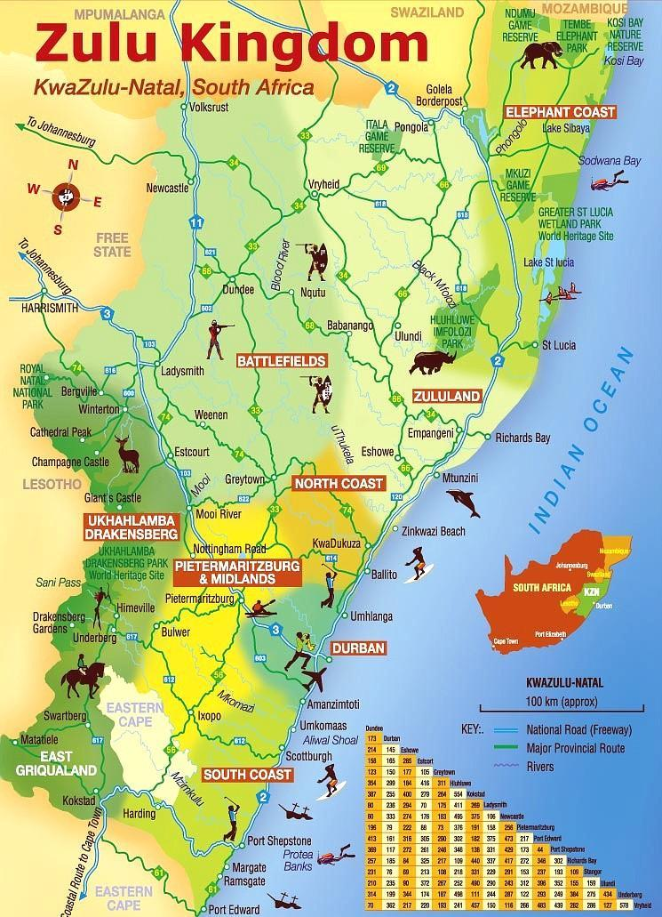

Slide 43
Enhance Local and Global Mission: Our Companion Synod - not true?
Zulu Culture
Conflict about bishop election
Political struggles - who controls the land
Deep grief and conflict - lost investment that had fueled churchwide offices and seminary
Most attend seminary using correspondence courses.

Slide 44
Accompaniment
Mutuality
Inclusivity
Vulnerability
Empowerment
Sustainability

Slide 45
Youth and Family Ministry

Slide 46
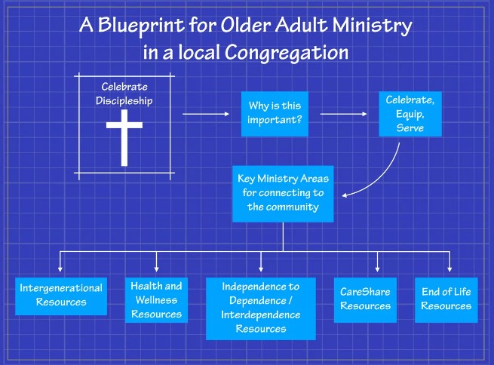

Slide 47
Conflict
Conflict

Slide 48
How is your community becoming more diverse? How is your congregation responding?

Slide 49
What diversity is most important in this list?
Education
Time in a community
Financial power
Language
Racial

Slide 50
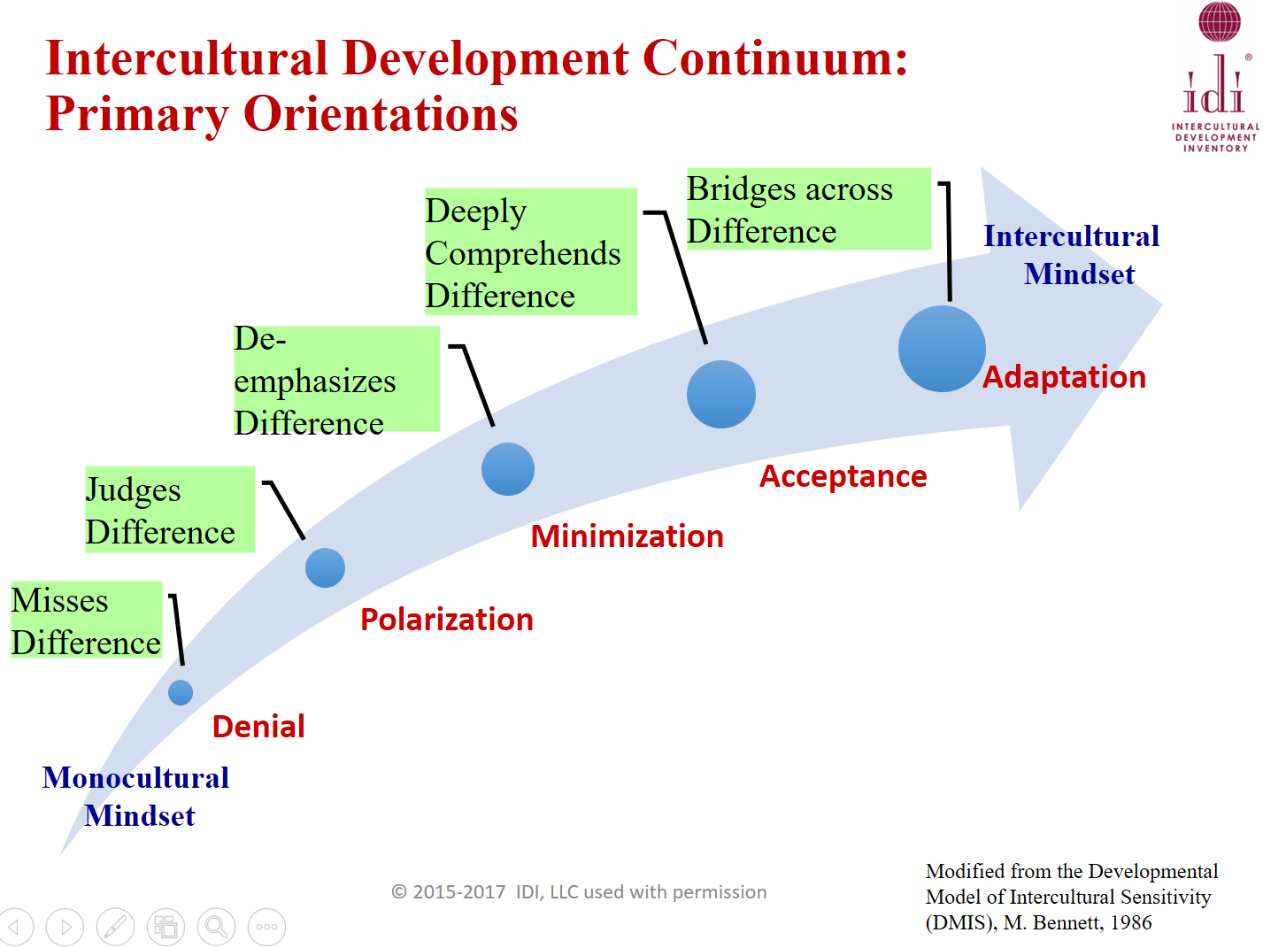

Slide 51


Slide 52
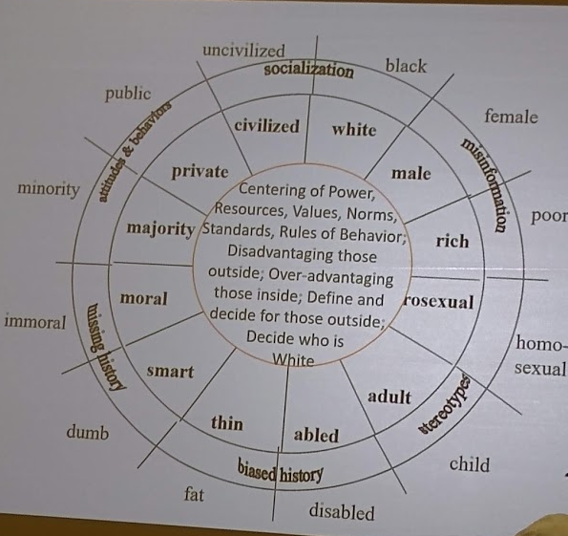

Slide 53
What is the fastest growing religious group in our country?
Baptist
Non-Denominational
Assembly of God
Muslim
Buddhist
Nones / Dones

Slide 54
If you received a gift of $1,000,000, how would you move?
  10% to Churchwide
  50% now
  40% for endowment support of ministry opportunities
Do you have a policy?

Slide 55
Different streams of support
  Mission Support
  Annual Fund – Advent Appeal
  Grants from ELCA and other entities e.g. Lilly
  Capital Fund Campaign – Strategic Initiatives
  Online Strategies – Social Media
  Bequests - Planned Giving –
  Congregational Endowments Partnerships
Notes:
Which one more information about

Slide 56


Slide 57
ELCA Churchwide – what excites you?
Constitutional Updates
Faith, Sexism, and Justice: A Lutheran Call to Action
“A Declaration of Inter-Religious Commitment: A policy statement of the ELCA
Election – Secretary & Presiding Bishop

Slide 58
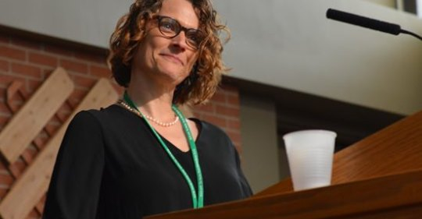
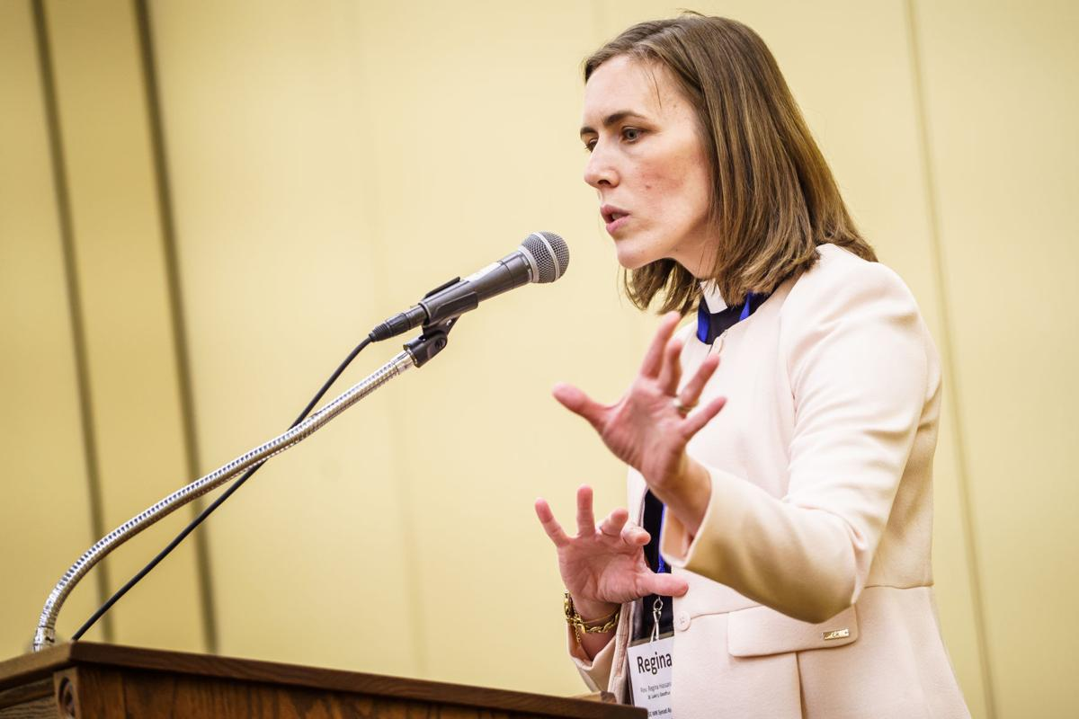
Celebrating New Leadership
Bishop Elect Regina Hassanally
Bishop Elect Constanze Hagmeier

Slide 59
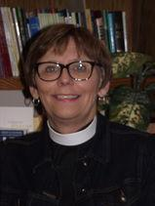
Celebrating New Leadership
Bishop Elect
NW MN?
Bishop Elect Lorna Halaas

Slide 60
  Develop Servant Leaders

Slide 61
We equip leaders
to grow gracious disciples
in communities of Jesus
who care for God’s world.

Slide 62
Culture of Call
The Baptized
Surfacing and Supporting Candidates / Leaders
Rostered Ministers
Lay Staff - ministers
Notes:
Follow the money - Scholarships – Educational Debt
common good and the well-being of every child of God

Slide 63
What do our Jr. High and Sr. High Youth synod youth gatherings share?

Slide 64
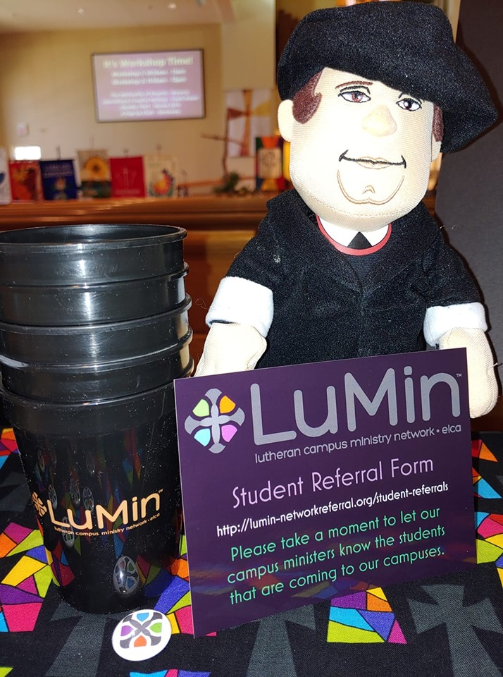

Slide 65
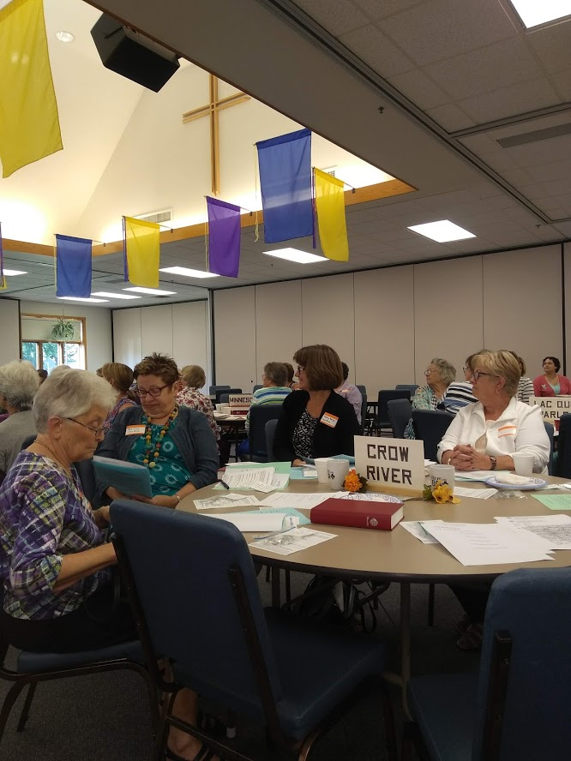
Equipping – Lay People
Bible Study
One on one training
Lay preaching
Worship leadership
Faith formation
Social Media – Sharing our story

Slide 66
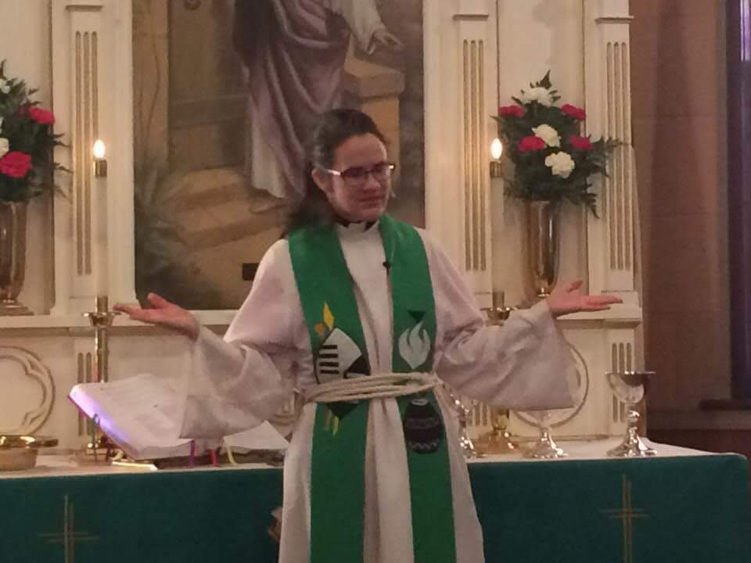
Leadership – Rostered Ministers
Preaching
Worship Leadership
Systems Thinking
Communication
Faith Formation
Faithful innovation

Slide 67
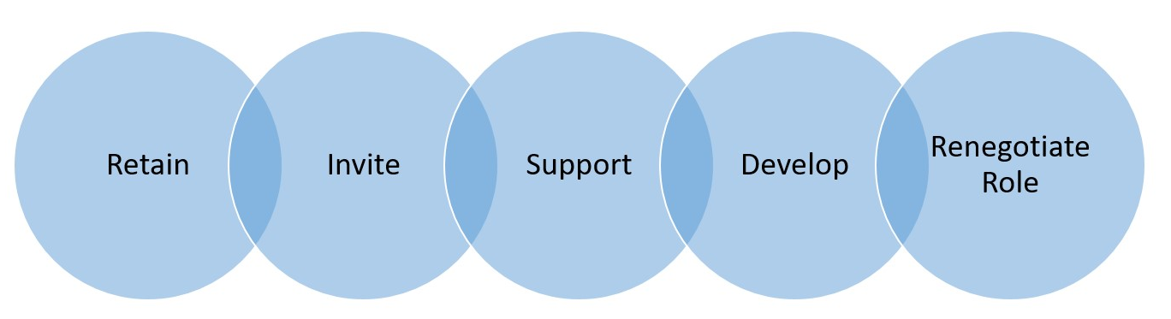
Rostered and Lay Ministers

Slide 68
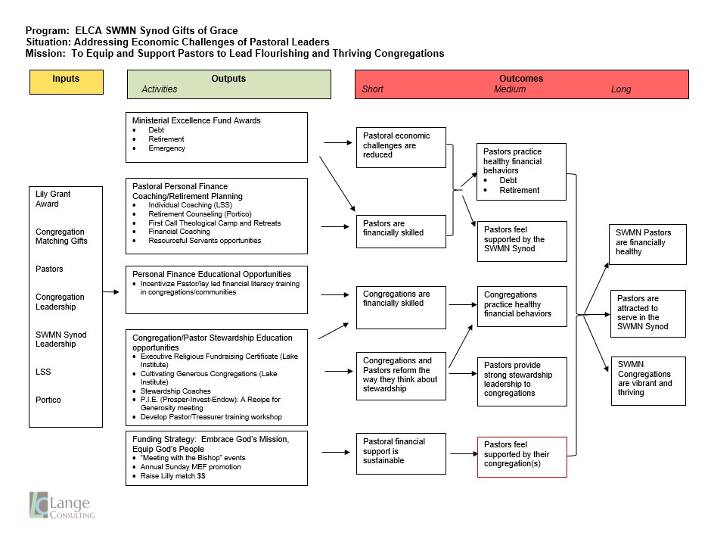

Slide 69
Southwestern Minnesota Synod congregations are vibrant and thriving….

Slide 70
How many paths to ordained ministry exist today?
Residential Mdiv
Distributed Learning
TEEM
Collaborative
MDivX – 2 year -
2 + 2 (online)

Slide 71
What is the most important continuing education expectation we should have?
Take a class that takes you into your community or non-church Cont. Ed.
50 hours Cont. Ed. Units CEUs

Slide 72
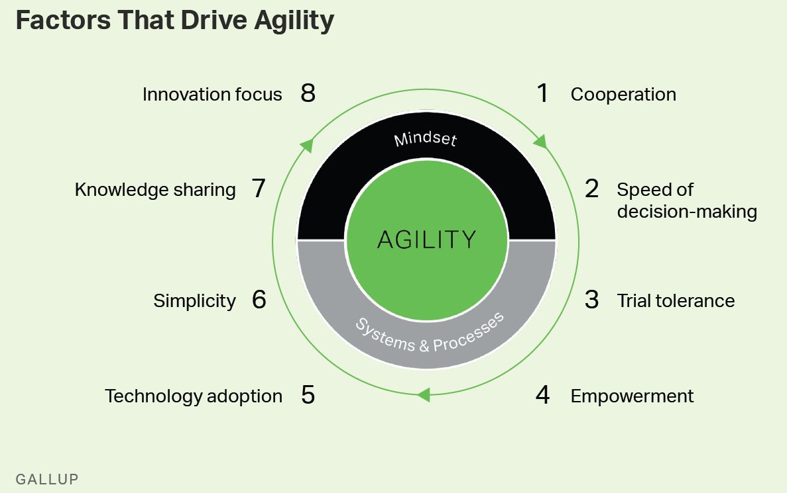

Slide 73
Every Congregation has a Pastor
If transition – Acting Pastor
If authorized minister – Supervising Pastor
Interim
  Interim Pastor
  Transitional Pastor

Slide 74
Supporting Neighboring Congregations in Transition
Acting Pastor -
  Worship coverage
  Council Meetings
  Close Ground Support
  Funerals
  Compensated
    Share cong. And pastor
  Contract
  Until interim is in place

Slide 75
Synodically Authorized Ministry Site
Not the person who is a SAM
Site is the SAM
Service of Word – One week of absence
Service of Word and Sacrament – President requests - No other pastors available – Letter of authorization – background check and training

Slide 76

Long Range Plan Questions
What’s working around here?
What is not working so well?
What will make us better?
What keeps us from improving?
What should we move to the forefront?

Slide 77
We equip leaders
to grow gracious disciples
in communities of Jesus
who care for God’s world.

Slide 78
Resilient Everyday Spirituality

Slide 79
God calls people deeper in faith, hope and love as gracious resilient disciples.
God is the center of Congregational Vitality. God is the primary agent….and the center of our life.

Slide 80
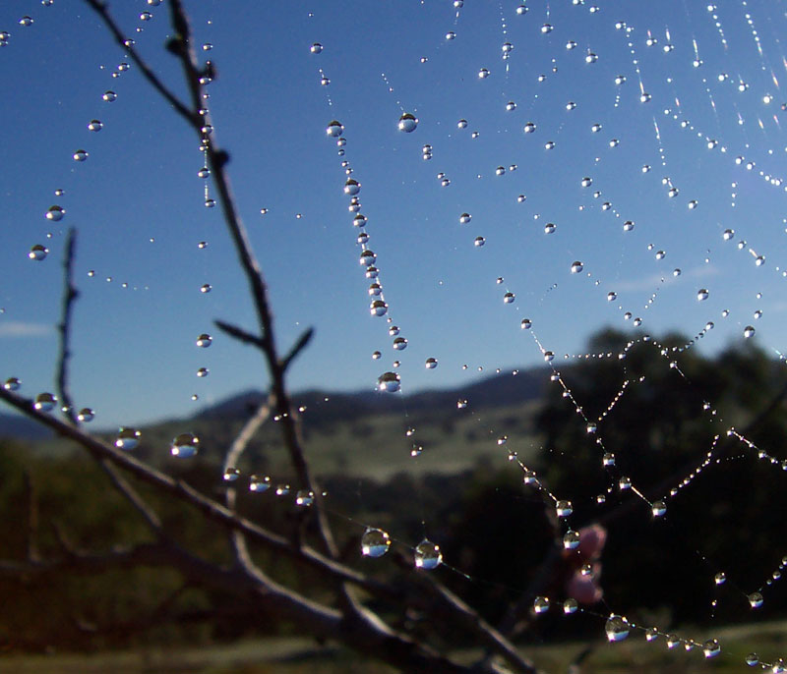

Slide 81


Slide 82

Noticing

Slide 83
Congregational Vitality: What is one idea you have about changing your trajectory?

