Slide 1
Telling Our Story and
Being Invitational Christians
Dave Daubert
October 2018
Southwestern Minnesota Synod

Slide 2
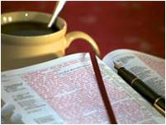
Opening Scripture and Prayer

Slide 3
Part One:
The Dilemma

Slide 4

Church is off most radars
About 12% of Americans attend church in a typical week
35% of people under age 30 have no church affiliation
Many families are 3-5 generations deep being unchurched

Slide 5

Current ELCA Statistics
Worship attendance is under 900,000 people per week.
Average congregational attendance is under 100 per week
Median attendance is 61

Slide 6
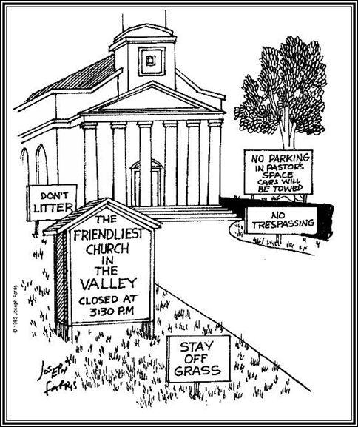
People drive by churches all the time.
Why stop at any? Why stop at yours?

Slide 7
A Silly Question:
Do you want to go to church?
There are supposedly no dumb questions
(but this one generally is pretty close)

Slide 8

A high percentage of Americans don’t really know what church even is!

Slide 9
“Nice is not enough”
When I ask Lutherans across the country, “Why should someone come to your church?” the number one answer is, we have such nice people here.
People who consider checking out church don’t come looking for nice people, they come looking for God

Slide 10

Telling Our Congregation’s Story
What is it?

Slide 11

The Lutheran Insight
(We have something to offer)
Brian McLaren says, “If you want a feel for the richness of the phrase ‘Word of God,’ ask the Lutherans; it’s a secret that their own tradition seems to know without knowing what it means.”

Slide 12
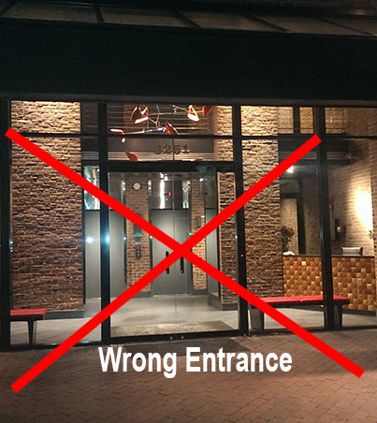
We Are Using the Wrong “In”
It would be nice if the “in” was God in Christ
We are mostly connected by a sociological “in”
  History
  Ethnicity
  Cultural preferences
  Geography
  Family

Slide 13
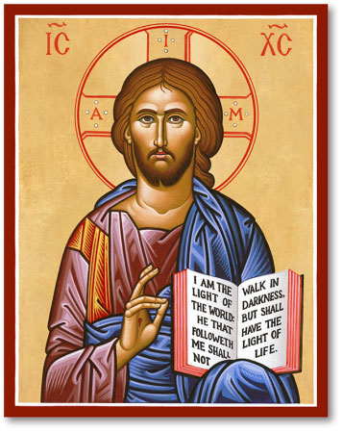
Research is clear: Unchurched people are less interested in church than in Jesus.
The more you focus on religion as the reason to attend, the more likely you are to miss the audience.
The more you focus on the God we meet in Jesus, the more likely you are to have an audience!

Slide 14
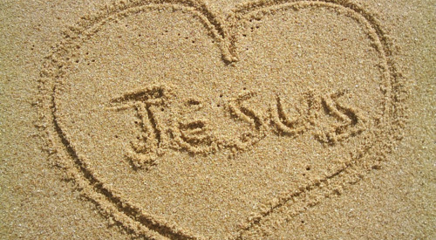
Is Christ our Entrance in the ELCA?

Slide 15
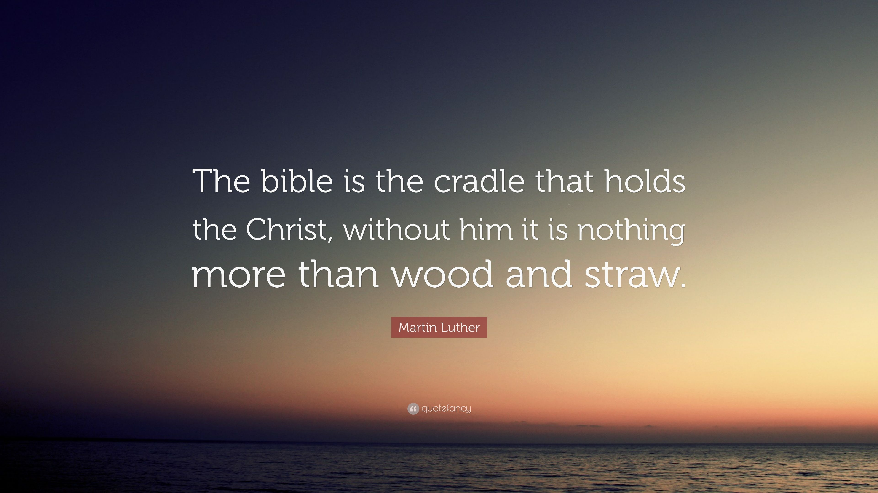
The Bible points to Jesus

Slide 16

What is God’s ongoing story?
Elevator speech about biblical narrative.

Slide 17

Congregational story as extension of God’s ongoing story

Slide 18
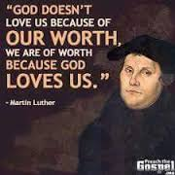
Martin Luther
The Reformer 500 Years Later

Slide 19
The Invitational Christian

Slide 20

My Story

Slide 21
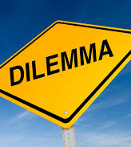
Invitation – The Dilemma
People in vibrant Lutheran congregations still don’t invite much. Why?

Slide 22

Three Issues That Plague Us
Don’t want to be a nuisance or fanatic
We often do a poor job of inviting..
Once a poorly given invitation is given, the speaker often internalizes, “I invited them but they didn’t come. They must not be interested.”

Slide 23

Fact:
82% of unchurched people would say “yes” to an invitation from a trusted friend.”

Slide 24
1. Why Should Anyone Come?

Slide 25

1. Why Should Anyone Come?
Purpose: What we do matters to God
Discipleship: Participating in the congregation is spiritually life changing

Slide 26
1 – A: Purpose

Slide 27

Purpose
GOD’S purpose – why does God have your congregation here?
How does your congregation lift up and show people the Reign of God?

Slide 28
The Lord’s Prayer
Our Father in heaven, hallowed be your name,
your kingdom come, your will be done,
on earth as in heaven.
Give us today our daily bread.
Forgive us our sins
as we forgive those who sin against us.
Save us from the time of trial
and deliver us from evil.
For the kingdom, the power,
and the glory are yours,
now and forever. Amen

Slide 29
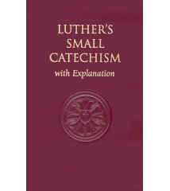
Luther’s Small Catechism
“To be sure, the kingdom of God comes of itself, without our prayer, but we pray in this petition that it may also come to us.”

Slide 30
Jesus is About
God Coming in to the World
Love comes down!!

Slide 31
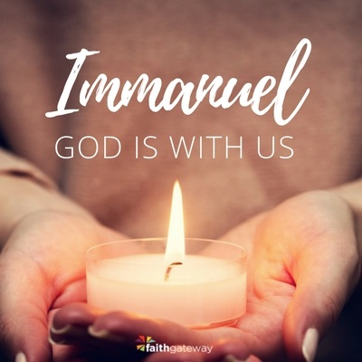
Incarnation

Slide 32
Two Possible Interpretations
Jesus coming is the boldest example of a God who comes to us again and again and again. God sent Jesus as a part of a pattern of “showing up.” This means Christ is present today.
Jesus showed up as a special case. God sent Jesus as a one time thing. In this case, Jesus is viewed as a “one and done.” This relegates Jesus to the past only.
?

Slide 33
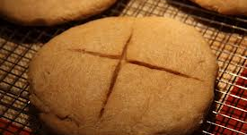
Sacramental Churches Believe
God Keeps Showing Up

Slide 34

The Most Important Thing:
An active and abiding God
Is God active and abiding for people in your congregation or not?
How do the people see and experience God?
How do they describe God and talk about God’s activity?

Slide 35

“God’s Church does not have a mission. God’s mission has a church.”

Slide 36

One Building Block of Renewal:
Missional Consciousness

Slide 37
1-B: Spiritual Growth and Discipleship

Slide 38
Spiritual Maturity Profile
(Based on TLI Reveal Study)
Exploring Christ (functional agnostics) – 25%
Growing in Christ (catechetical knowledge) – 47%
Close to Christ (relational Christianity) – 19%
Christ-centered (sacrificial discipleship) – 9%

Slide 39
Spiritual Maturity Profile
(Based on TLI Reveal Study)
}72%
Exploring Christ (functional agnostics) – 25%
Growing in Christ (catechism knowledge) – 47%
Close to Christ (relational Christianity) – 19%
Christ-centered (sacrificial discipleship) – 9%

Slide 40
Spiritual Maturity Profile
(Based on TLI Reveal Study)
Exploring Christ (functional agnostics) – 25%
Growing in Christ (catechism knowledge) – 47%
Close to Christ (relational Christianity) – 19%
Christ-centered (sacrificial discipleship) – 9%
}28%
This group has God
Present and active

Slide 41
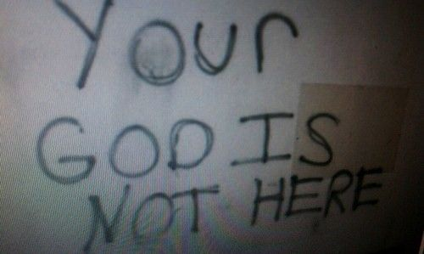
We Have Unintentionally Taught People
“God is not present and active”

Slide 42
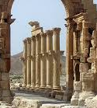
The Apostles Creed
“Theological archaeology?”
Jesus
  Was conceived
  Born
  Suffered
  Crucified
  Died
  Was buried
  Rose
  Descended
  Is seated (in heaven)
  Will come (some day)

Slide 43
Luther’s Quest
Help People Trust a Present God
I believe that God has made me and all creatures; God has given me my body...
and still takes care of them.
also gives me clothing...
richly and daily provides me...
defends me... and protects me... All this God does only out of fatherly, divine goodness and mercy, without any merit or worthiness in me. For all this it is my duty to thank and praise, serve and obey him. This is most certainly true.

Slide 44
P: Let us declare our faith in God.
We believe in God the Father,
from whom every family
in heaven and on earth is named.
We believe in God the Son, crucified and risen, who lives in our hearts through faith, and fills us with his love.

Slide 45
We believe in God the Holy Spirit,
who strengthens us
with power from on high.
We believe in one God;
Father, Son and Holy Spirit.
Amen.

Slide 46
A New Creed – United Church of Canada
We are not alone,
we live in God’s world.
We believe in God:
who has created and is creating,
who has come in Jesus,
the Word made flesh,
to reconcile and make new,
who works in us and others
by the Spirit.
We trust in God.

Slide 47
We are called to be the Church:
to celebrate God’s presence,
to live with respect in Creation,
to love and serve others,
to seek justice and resist evil,
to proclaim Jesus, crucified and risen,
our judge and our hope.
In life, in death, in life beyond death,
God is with us.
We are not alone. Thanks be to God.

Slide 48
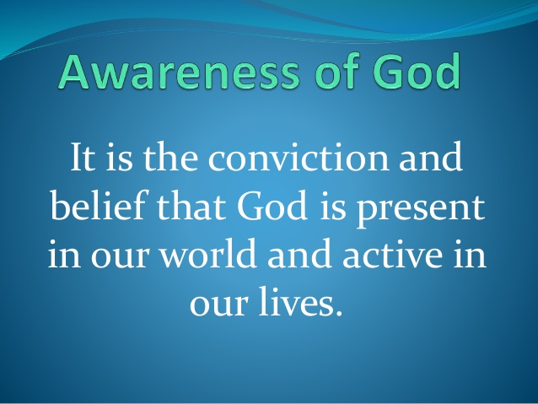
Another Building Block of Renewal

Slide 49

The ELCA (in general) is Spiritually Immature

Slide 50
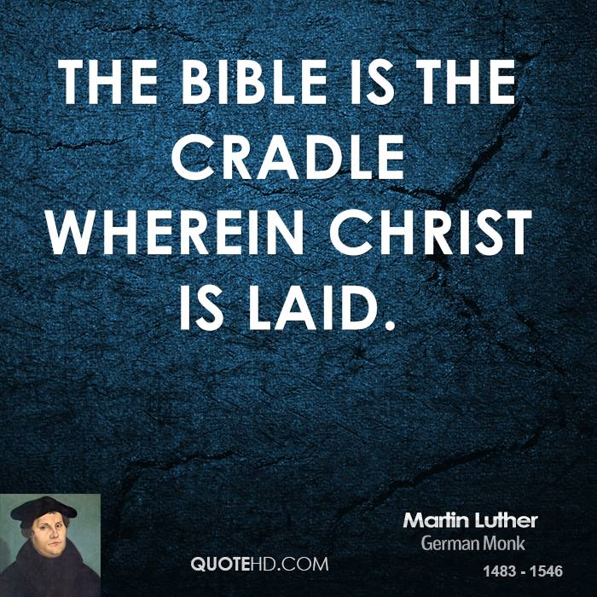
Prayer and Scripture
(Spending time with God - Christ)
If you don’t know what to do, get people reading their Bible and talking with others about what they read
Jews: “Start with scripture (God gets the FIRST word)
Help people learn to pray (most report they don’t know how)

Slide 51
At Your Seats
How clear are the people in your congregation about:
  Why God has your congregation where it is?
  How to grow as disciples of Jesus?

Slide 52

Turn to your neighbor

Slide 53
Take a Minute to Think
What if someone who hasn’t attended church for a long time said, “Tell me about your church. Why should someone like me attend?”
  What would you want to tell them?
  If you only had 30 seconds, what would you say to summarize what makes your congregation unique?

Slide 54
Turn to your neighbor

Slide 55

Take a Break

Slide 56
2. Knowing Our Story

Slide 57

2. Knowing Our Story
Everyone has a faith story. To share it requires a sense that God is present and active in our world and in our lives.

Slide 58

Three Things to Help People See God as Active and Present in Their Lives
Preaching needs to attend to the notion of how God is active in our world and in our lives.
Conversations need to be shaped and the congregation needs to be a safe place for people to discuss this.
Spiritual practice needs to be strengthened

Slide 59
A Simple Exercise
Beginning to Share Your Faith Story
Think about the phases in your life when you became more conscious of the fact that Jesus really loves you.
Who are three person(s) who made that come to life for you?
How did they do it?

Slide 60

Daily Life:
Our Ongoing Connection to an Active God
Our lives and work matter
Our hands, feet and voice are extensions of those of Jesus.
Our lives continue the work of Jesus.
We join WITH God in the work.

Slide 61
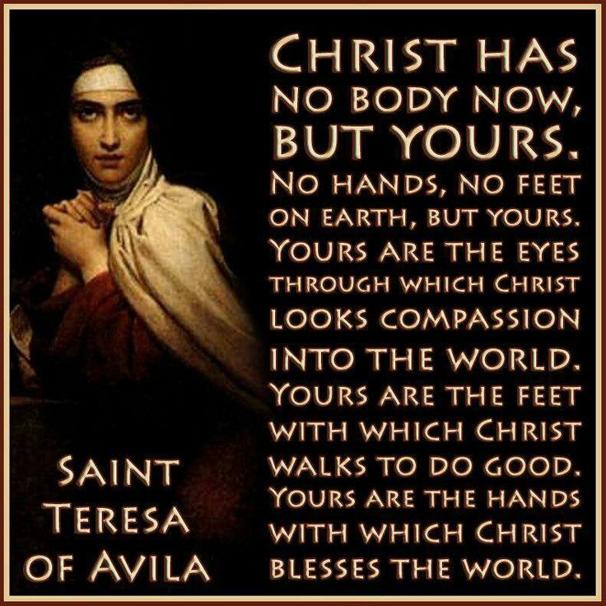
St. Teresa of Avila:
Our Bodies are Sacramental

Slide 62
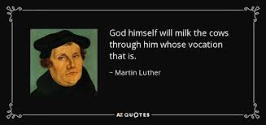
Vocation:
ALL of life matters to God
Vocation – we are “called” to join our work to God’s
In our baptism we are joined to the work of Jesus (our baptismal calling)
Calling is less WHAT we do and more WHY and HOW we do it!
www.theologyofwork.org

Slide 63

Vocational Work
Vocational Interviews
  Tell us about the work you do.
  How does what you do contribute to the world God loves?
  What are some issues you face at work?
  How does your faith make a difference in how you deal with these issues?
  How can we be praying for you?

Slide 64
3. Quality Matters

Slide 65

3. Quality Matters
Worship
Music
Preaching
Clutter
Hospitality

Slide 66
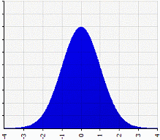
A Reminder of Basic Math
Average of almost everything is 50th percentile.
By definition half of everything is below average

Slide 67
A Reminder of Basic Math
Average of almost everything is 50th percentile.
By definition half of everything is below average

Slide 68
A Reminder of Basic Math
85% of all ELCA congregations are stagnant or in decline

Slide 69
A Reminder of Basic Math
85% of all ELCA congregations are stagnant or in decline
Even a number of “above average” ELCA congregations are stagnant or declining

Slide 70

If You Are Not “Above Average” in a Lot,
It Will Be Harder to Grow
People often say:
“I love my church but I don’t know if my friends will like it.”
“I feel at home in my congregation, but I don’t know if I am actually growing in my faith.”

Slide 71

When You Have Company at Home...
You clean up!
Move/hide the mess!
You make things look good.
The more special the guests, the more attention you give to this!

Slide 72

Many Churches Look Like
No One Expects Anyone Special This Week

Slide 73
Remember – It’s a Matrix
You Don’t Have to Be Amazing at Everything!
Worship
Music
Preaching
Clutter
Hospitality

Slide 74
4. Address People’s Fears

Slide 75
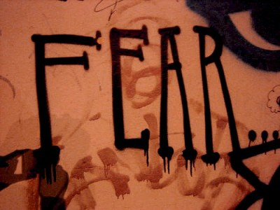
Talk About Them Out Loud
Fear works on us twice in church
Saying it OUT LOUD weakens fear’s power
Acknowledging it makes people feel understood

Slide 76

Fear of Fanaticism

Slide 77
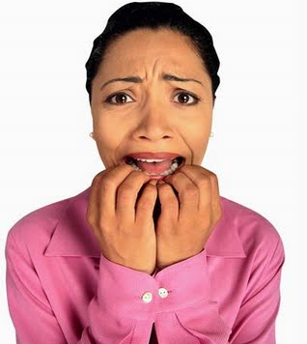
I Don’t Want Them to Judge Me:
The two things we don’t talk about: Religion and politics.
What if I cross a taboo line and they judge me for it?

Slide 78

Fear of Rejection
Rejection can be short term
But people also fear longer term consequences:
“What if this person, who I like, now decides not to hang out with me any more?”

Slide 79
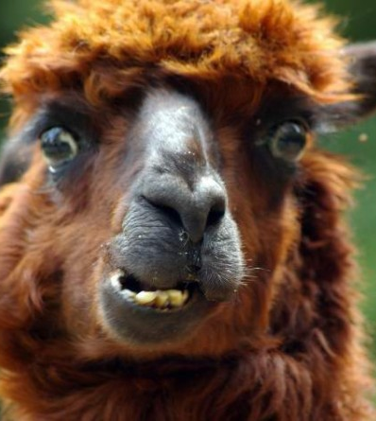
Fear of Feeling Foolish
“I don’t know enough”
No one wants to look stupid.
A good response: “I don’t know. That’s a good question. How about I ask my pastor and then get back to you?”

Slide 80

Teach People to Test the Waters

Slide 81
5. Give Them Tools

Slide 82
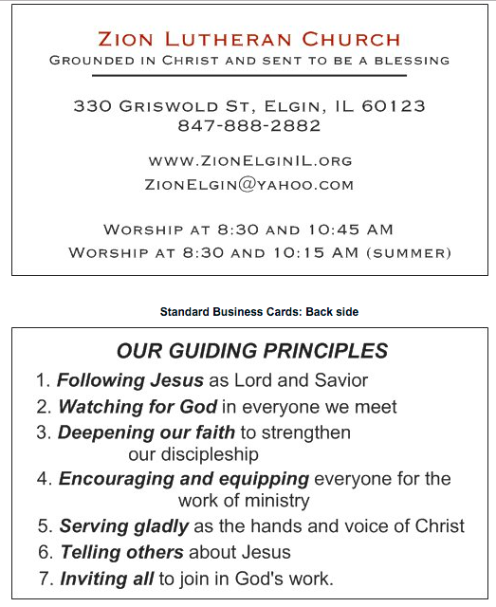
5. Give Them Tools
Business cards for members
Brochures and other literature

Slide 83
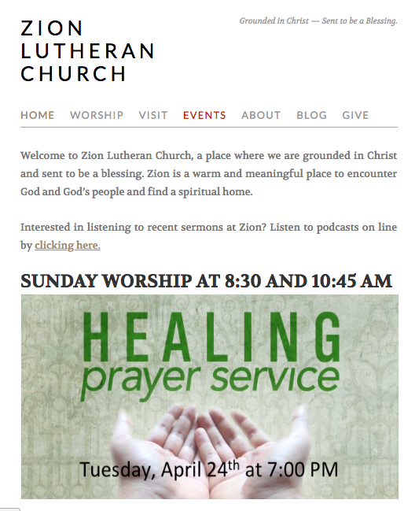
Give Them Tools
Your Web Presence
Simple and clean
Regular updates – you can make your own graphics in PowerPoint
Consider a weekly blog and teach people how to help it work
Interact between web site and social media

Slide 84

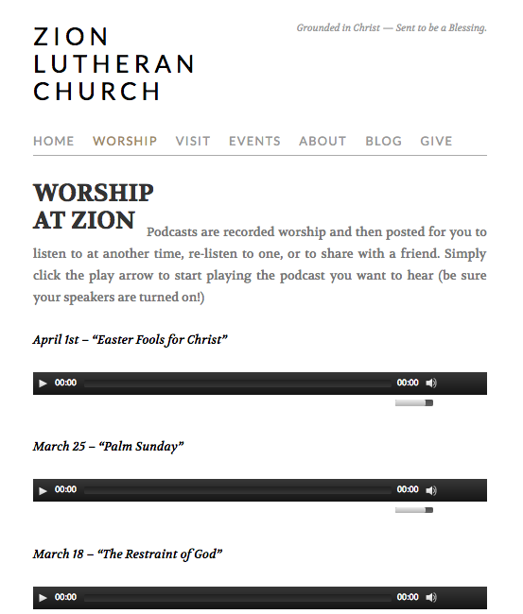
Podcasting
You can let people hear the preaching prior to coming
You can listen to other people’s preaching, too!
Media is an essential doorway into faith community

Slide 85

Social Media
Pick only what you can keep up with
Lack of new posts is worse than no page
Consider Facebook plus either Instagram or Twitter

Slide 86
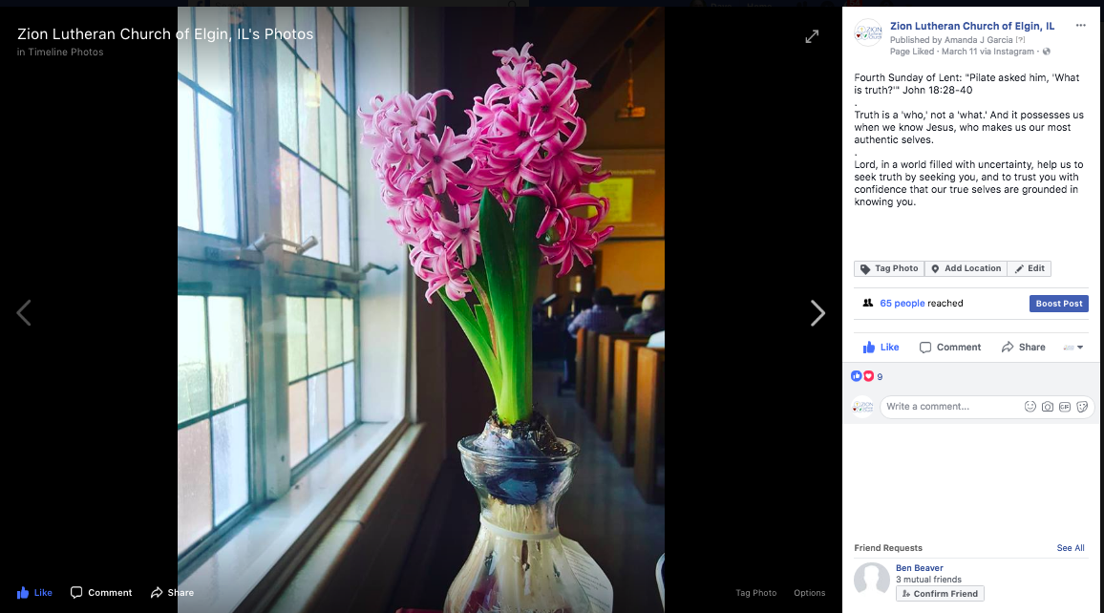
Link Social Media Sites to Save Work

Slide 87

Use Email Strategically
Thursday Thoughts – a blog on Sunday’s theme
Weekend Update – a Friday email with the weekend calendar – special events highlighted

Slide 88

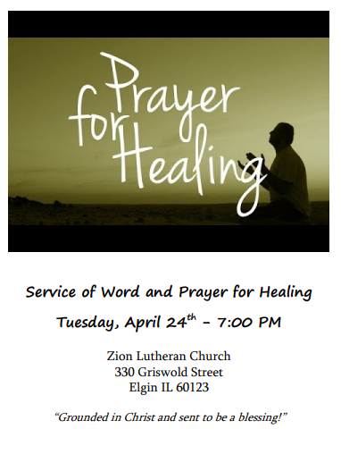
Give them Tools
Invitations

Slide 89
6. The Importance of “With”

Slide 90

6. The Importance of “With”
People visiting a new congregation are nervous
Don’t know anyone
Many people don’t know about church practices

Slide 91

Two Stories of Failed “Successes”

Slide 92
In Declining Congregations
Most Visitors Come On Their Own
Visitors who come with someone
Visitors who come on their own
(less than 10% of self-directed
Visitors join the congregation)

Slide 93
Growing Congregations
80% of Visitors Come With Someone
Visitors who come with someone
(These people are MUCH more
likely to connect and stay!)
Visitors who come on their own
(less than 10% of self-directed
Visitors join the congregation)

Slide 94
Comparing Growing and Shrinking Congregations
Visitors who come with someone
(These people are MUCH more
likely to connect and stay!)
Visitors who come on their own
(less than 10% of self-directed
Visitors join the congregation)

Slide 95
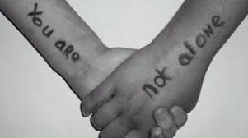
“With”
“I’d like you to come to church with me. I go to the 8:30 service. Can I pick you up about 8:10 and we’ll go together? Then we can go out to brunch afterward together – my treat.”

Slide 96
7. Follow Up

Slide 97

7. Follow Up
Thank you notes from person who invited the guest as well as the pastor.
Get contact info – easier with invited guests.
Visit or phone conversations
Invitations to more meaningful activity

Slide 98

Provide Helpful Next Steps
Service opportunities
Learning opportunities and inquirer’s classes
People connections
Out loud invitations for people to consider committing
A clear path to membership and discipleship

Slide 99

At Your Seats
How does your congregation follow up with first time visitors?
How consistent are you at this?
What next steps follow and how intentionally are these steps laid out?

Slide 100
Think About What’s Next

Slide 101
Let’s Quickly Review
Why Should Anyone Come?
  Congregational Purpose
  Spiritual Growth
Know Your Faith Story
Quality Matters
Address People’s Fears
Give Them Tools
The Importance of “with”
Follow Up

Slide 102

Go Home With A Plan
What 3 Steps can you take when you go home?
How will you share what you have learned?
Where should you begin?
Who do you need to talk to to begin?

Slide 103
Q & A

Slide 104
My Contact Info
DDaubert@Day8Strategies.com
www.Day8Strategies.com
10% off discounts on resources using
Coupon Code: WORKSHOP10

