Slide 1
Church Communication Today
By Scott Vaughan
Scott Vaughan Communications
Copyright 2017

Slide 2
Why should we prioritize communication?
“Go make disciples . . .” – Matthew 28:19.
“They went out and spread the news” – Matthew 9:26
We are in the relationship business – Luke 10:27
We are all “people, people” – Genesis 1:27
Kill the communication . . . Starve off the relationship.

Slide 3
How we use communication
To strengthen relationships within the community of faith.
To create a climate that helps people see the messages of the church.
To plant seeds of faith.
To empower people to make Jesus known to others.
The purpose of communication is not to be attractional.
The purpose of communication is to be missional.

Slide 4
The promotion formula
The best message to . . .
The best audience by . . .
The best method at . . .
The best time.
This puts pressure on
Communication management
How we see the communication budget
What we do and promote as a church and to what end

Slide 5
How communication has changed
1999 – Fear over Y2K signaled something
2000 – 51 percent of households owned a computer
2001 – Email was normalized
2004 – A $16 billion drop in direct mail began, ending in 2013.
2008 – Text-messaging began an impact on American culture
2009 – Facebook installs the ‘Like’ button
2010 – Internet use doubled since 2007
2017 – Email saturation / Facebook pay-to-play signaling something

Slide 6
Management makes or breaks the process
A part- or full-time staff member
A committee or team approach
Outsourcing key responsibilities
Churches must provide time and budget for managers to explore communication methods and how to use them.
Churches must invest in functional writers.

Slide 7
The budget
Financing communication is not an expense. Financing communication is an investment.

Slide 8
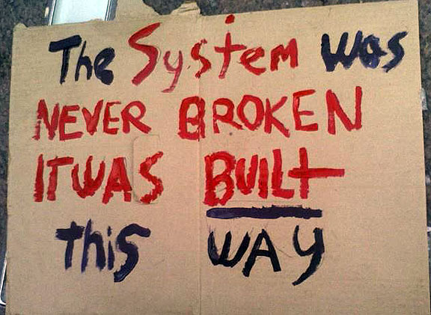
The Communication System: A Review
Database Management & Audience Identification
Management & Budgeting
Creating a Climate
Digital Communication
Print Communication
Interpersonal Communication
Hospitality Ministry
Daily reception; Ushers, Greeters & Hospitality Ministry
Follow-Up with Guests

Slide 9
Research is important to understanding
Discussion Groups
Surveys
Community Studies
Debriefing ministry events and activities
Massaging the database

Slide 10
The church brand
Consistency in logo, color, typeface presentation.
Scalable.
Understandable.
Meaningful.

Slide 11
Today’s website
Gets you into the marketplace.
Is guest focused with a handful of crossover pages.
Minimal pages.
Designed with the responsiveness to smart telephones and tablets.
Scrolling is okay – more and more on the Home Page.
Multiple sites are okay.

Slide 12
Social Media
Facebook is King.
Facebook Live! and Video in the church.
Social Media In the United States
About 90 percent of those 18-29 use social media.
About 35 percent of those over 65 use social media (tripled since 2010).
More than 50 percent in lowest income households use social media. (56)
In 2013, more than half of those with high school diploma or less were using social media.
Race and Ethnicity have no affect on social media usage.
Even in rural areas, more than 50 percent of people use social media.
Source: Pew Research

Slide 13
Social Media
Social Media
Platform | Users
1. Facebook | 1.59 billion
2. Whatsapp (Mobile Messaging) | 1 billion
You Tube | 1 billion
8. Instagram | 400 million
9. Twitter | 320 million
11. Skype | 300 million
14. Snapchat | 200 million
17. Pinterest | 100 million
19. LinkedIn | 100 million

Slide 14
E-Mail
Get a handle on all that e-mail leaving the church.
Most diagnostics indicate 20-25 percent of e-mail is opened.
Yet, it’s possible to reach 98 percent of those under 65 with e-mail.
But, more than 4-6 per month quickly burns a database.

Slide 15
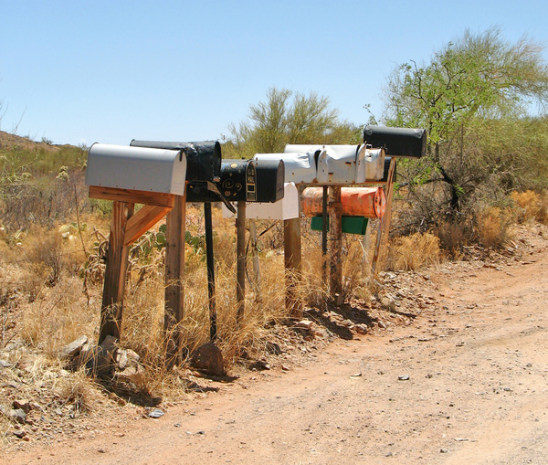
Post Cards
About 70 percent of churches report printing / mailing a newsletter.
Many churches are replacing the old print newsletter with a monthly post card that can also be used as a neighborhood invitation.

Slide 16
What about print?
A monthly printed and mailed newsletter is acceptable provided it’s not type-heavy and can be easily read.
Beware the worship bulletin.
Stop the tri-fold brochures for every ministry.
Packets.
Flyers . . . Think posters instead.
Bulletin boards are out.

Slide 17
Announcements
Worship is not a promotion environment or a town hall meeting.
Keep announcements to a few, and keep them simple.
Slides should be black on white with colorful art.
Include video announcements

Slide 18
Take a big deep breath
Checklist for smaller membership churches
Strengthen your usher and greeter ministry
Have a simple website – even if it’s just one page advertising your Sunday services, prayer ministry, pastor, and how to contact you.
Have a Facebook Page, and post every morning.
Send a weekly email to all of your members and guests.
Keep your Sunday announcements simple. Keep your bulletin simple.
Consider 4-6 post cards throughout the year.
Have a system of follow-up with guests.

Slide 19
www.svministry.com
www.shopsvministry.com
scott@svministry.com
(803) 315-0234
Notes:
19

