Slide 1
Southwestern Minnesota Synod Bishop Election Report - Presentation
John Hessian
ELCA Research, Analysis and Data
April 27, 2021

Slide 2
Who will fill these boots?
The people of the Southwestern Minnesota Synod will call a new bishop to replace Bishop Jon Anderson after 18 years of service.

Slide 3
Presentation Outline
Territory of Southwestern Minnesota
Survey Summary
Membership and Financial Statistics

Slide 4
Territory, Demographics and Religious Landscape

Slide 5
Territory in Square Miles
Southwestern Minnesota is the 37th largest synod geographically. Alaska is the largest and the Saint Paul Area is the smallest.
Southwestern Minnesota is much larger than the Saint Paul Area, Minneapolis Area or Southeastern Minnesota Synods.

Slide 6
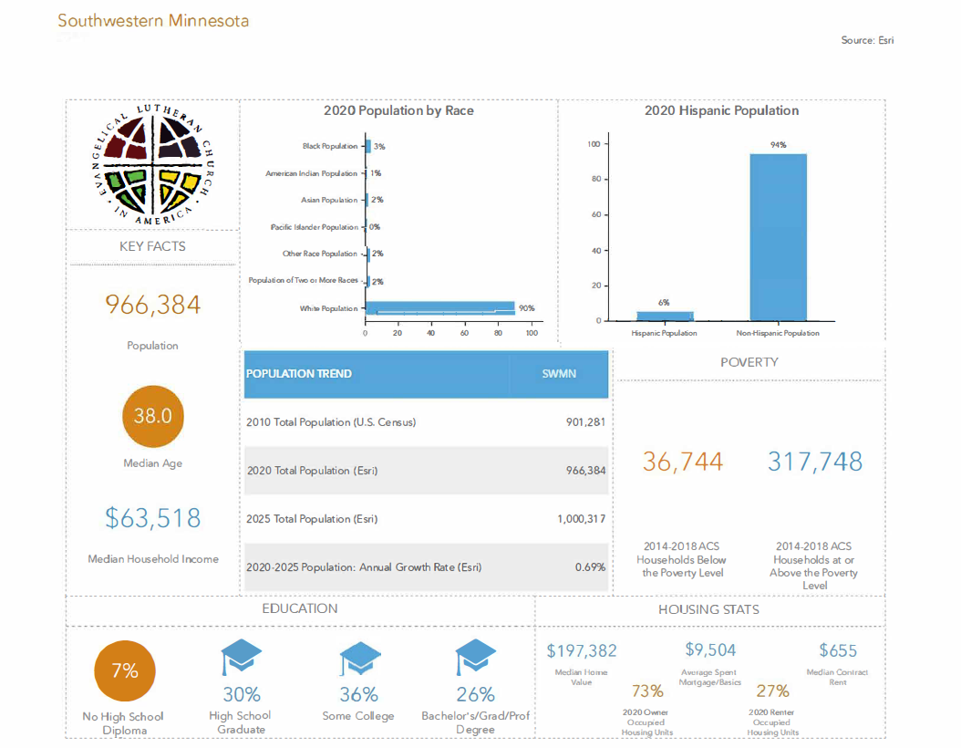

Slide 7
Population Projection 2020-2025 Average Attendance Changes 2017-2019
The population in the northeastern part of the synod is expected to grow from 2020 – 2025.
However, average attendance at most congregations declined from 2017 - 2019.

Slide 9
Population of the Southwestern Minnesota Synod

Slide 10
ELCA congregations play a prominent role in the life of Southwestern Minnesota.
In 2010, 136,235 people were baptized members of ELCA congregations. The ELCA is the most prevalent mainline denomination in Southwestern Minnesota. 78% of all people claimed by mainline denominations are ELCA Lutherans.

Slide 11
Survey Summary

Slide 12
Over half of the respondents are lay members or active participants of SW Minnesota congregations. (N=345)
Over half of the respondents are 61 or older. (N=348)

Slide 13
Knowledge of the Synod Office
Most of the respondents have a relatively good or very good understanding of the functions and activities of the synod office. (N=409)

Slide 14
Foci | # of Responses
Green Lake Lutheran Ministries | 346
Women of the ELCA | 345
Luther Seminary | 343
Evangelical Lutheran Church in South Africa | 332
Gustavus Adolphus College | 332
Lutheran Social Services of Minnesota | 324
Campus Ministry (various universities) | 316
Shetek Lutheran Ministry | 297
Lutheran Youth Organization | 267
Shalom Hill Farm | 266
Lutheran Men in Mission | 252
Luther Crest Bible Camp | 238
Minnesota Council of Churches | 221
Lutheran Advocacy – Minnesota | 171
Knowledge of Partnered Organizations
The respondents also are aware of the organizations with whom the synod partners.

Slide 15
Foci and Advice for the Next Bishop

Slide 16
Foci | # of Responses
Vision and Planning | 154
Evangelism and Outreach | 138
Pastoral Care of Rostered Ministers | 133
Building Healthy Community | 111
Healthy Conflict Management | 107
Children, Youth and Family Ministry | 101
Most Important Foci for Next Bishop
The respondents feel the most important area on which the next bishop should focus is vision and planning.

Slide 17
Delegate Responsibilities
□ Collaborate.
□ Get a good team and trust them to do their work.
□ You can’t do everything alone.
Be visible and Communicate
□ Make sure to visit congregations.
□ Make sure to be in communication with congregations.
Pray and Listen to the Holy Spirit
□ Faith must be your guide.
□ Walk in the path of Jesus.
Be a Unifier
□ COVID has caused so many disruptions and divisions.
□ Political and civil unrest have caused so many divisions.
Advice for the Next Bishop

Slide 18
Challenges, Opportunities and Building up God’s Mission

Slide 19
Relevance
General Decline of Church in People’s Lives
People are too busy to make time for church.
People are not as religious as they used to be.
Membership Decline
Attendance Decline
Attracting New People to Church
Rostered Minister Shortage
COVID-19 and its effects on church and society
Challenges

Slide 20
Increasing Ethnic Diversity in Southwestern Minnesota
Changing Demographics in Southwestern Minnesota
Learning about Anti-Racism
Technology
Online Presence of Congregations
Virtual Dimension to Church
Gospel Message
Lutheran Theology
Spreading the Good News
Community Outreach
Working Outside the Church’s Walls
Working with non-ELCA groups
Opportunities

Slide 21
Building up God’s Mission –
The work being done by the congregations of the SW Minnesota Synod
Proclaiming the Gospel
Preaching the Word
Sharing the Good News
Providing Food for Food Pantries
Providing Free Cooked Dinners
Providing Personal Items
Providing Clothes
Community Volunteering
Neighborhood Cleanup
God’s Work. Our Hands. Sunday

Slide 22
Membership and Financial Statistics

Slide 23
Baptized Membership

Slide 24
Congregations and Worshipers
Most of the congregations in the synod are small – 71% have 100 or fewer in worship in an average week.
A good portion of the people in SW Minnesota worship in larger churches – 41% of the average attendees worship in churches with 201 or more people in worship in an average week.

Slide 25
Synod | Total Giving Per Worship Attendee - 2009 | Total Giving per Worship Attendee - 2019
Saint Paul Area | $2,221 | $2,955
Minneapolis Area | $2,102 | $2,673
NE Minnesota | $1,872 | $2,190
SE Minnesota | $1,801 | $2,189
NW Minnesota | $1,618 | $2,023
SW Minnesota | $1,625 | $1,949
ELCA | $2,062 | $2,470
Annual Giving per Worship Attendee

Slide 26
Thank you very much and blessings to you as you meet in assembly to choose your next bishop.
John Hessian
ELCA Research, Analysis and Data
April 27, 2021

